Slide 1
Communication and Network Security

Slide 2
CISSP

Slide 3
Domain 1: Security and Risk Management
Domain 2: Asset Security
Domain 3: Security Architecture and Engineering
Domain 4: Communication and Network Security
Domain 5: Identity and Access Management
Domain 6: Security Assessment and Testing
Domain 7: Security Operations
Domain 8: Software Development Security

Slide 4
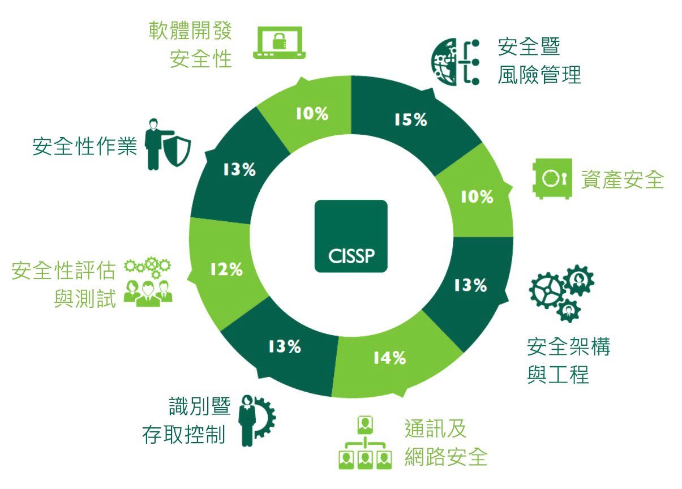

Slide 5
Domain 1—安全暨風險管理 Domain 1: Security and Risk Management
認識與應用機密性、完整性及可用性
評估與應用安全治理原則
判斷遵循性要求
認識全球背景下的資訊安全法令、法規議題
認識、遵守與推廣職業道德
制定與執行資訊安全之政策、標準、程序及指引
識別、分析與區分持續營運要求
建立與強制人員安全政策與程序
認識與應用風險管理
認識與應用威脅模型
供應鏈風險管理
建立與維護資訊安全認知、教育與訓練

Slide 6
Domain 1—安全暨風險管理 Domain 1: Security and Risk Management
認識與應用機密性、完整性及可用性
Understand and Apply Concepts of Confidentiality, Integrity, and Availability
評估與應用安全治理原則Evaluate and Apply Security Governance Principles
判斷遵循性要求 Determine Compliance Requirements
認識全球背景下的資訊安全法令、法規議題
Understand Legal and Regulatory Issues That Pertain to Information Security in a Global Context
認識、遵守與推廣職業道德 Understand, Adhere to, and Promote Professional Ethics
制定與執行資訊安全之政策、標準、程序及指引
Develop, Document, and Implement Security Policy, Standards, Procedures, and Guidelines
識別、分析與區分 持續營運之要求
Identify, Analyze, and Prioritize Business Continuity Requirements
建立與強制人員安全政策與程序
Contribute to and Enforce Personnel Security Policies and Procedures
認識與應用風險管理 Understand and Apply Risk Management Concepts
認識與應用威脅模型 Understand and Apply Threat Modeling Concepts and Methodologies
供應鏈之風險管理Apply Risk-Based Management Concepts to the Supply Chain
建立與維護 資訊安全認知、教育與訓練
Establish and Maintain a Security Awareness, Education, and Training Program

Slide 7
Domain 2—資產安全 Domain 2: Asset Security
Asset Security Concepts
資訊與資產 識別與分級
Identify and Classify Information and Assets
確認與管理資訊與資產擁有權
Determine and Maintain Information and Asset Ownership
隱私防護Protect Privacy
確保適當保存Ensure Appropriate Asset Retention
決定資料安控措施Determine Data Security Controls
建立作業要求 Establish Information and Asset Handling Requirements

Slide 8
Domain 3—安全架構與工程 Domain 3: Security Architecture and Engineering
採安全設計原則建置與管理工程生命週期
Implement and Manage Engineering Processes Using Secure Design Principles
認識安全模型 Understand the Fundamental Concepts of Security Models
基於系統安全要求選擇控制措施
Select Controls Based upon Systems Security Requirements
認識資訊系統安全能力Understand Security Capabilities of Information Systems
評估與減少 安全性架構、設計與解決方案 之 弱點
Assess and Mitigate the Vulnerabilities of Security Architectures, Designs, and Solution Elements
評估與減少 網站系統安全弱點Assess and Mitigate Vulnerabilities in Web-Based Systems
評估與減少 行動系統安全弱點Assess and Mitigate Vulnerabilities in Mobile Systems
評估與減少 嵌入式裝置與連網系統安全弱點
Assess and Mitigate Vulnerabilities in Embedded Devices
應用密碼學Apply Cryptography
空間設計時應用安全原則Apply Security Principles to Site and Facility Design
設計與建置設施安全Implement Site and Facility Security Controls

Slide 9
Domain 4—通訊及網路安全 Domain 4: Communication and Network Security
採安全原則設計網路架構 Implement Secure Design Principles in Network Architecture
保護網路元件 Secure Network Components
基於設計建立安全通道
Implement Secure Communication Channels According to Design

Slide 10
Domain 5—識別暨存取控制 Domain 5: Identity and Access Management
控制對資產的實體及邏輯存取
Control Physical and Logical Access to Assets
管理人員、裝置與服務的識別與鑑別
Manage Identification and Authentication of People, Devices,
and Services
整合第三方識別服務
Integrate Identity as a Third-Party Service
建置與管理授權機制
Implement and Manage Authorization Mechanisms
管理識別與存取供應生命週期
Manage the Identity and Access Provisioning Lifecycle

Slide 11
建置與管理授權機制 Implement and Manage Authorization Mechanisms
Role-Based Access Control
Rule-Based Access Control
Mandatory Access Control
Discretionary Access Control
Attribute-Based Access Control

Slide 12
Domain 6—安全性評估與測試 Domain 6: Security Assessment and Testing
設計與驗證評估、測試與稽核策略
Design and Validate Assessment, Test, and Audit Strategies
測試安控機制Conduct Security Control Testing
收集安全流程的資料Collect Security Process Data
分析測試結果與產出報告
Analyze Test Output and Generate Report
執行或協助安全稽核
Conduct or Facilitate Security Audits

Slide 13
Domain 7—安全性作業 Domain 7: Security Operations
認識與支援 調查過程Understand and Support Investigations
認識不同調查類型之要求Understand Requirements for Investigation Types
紀錄與監控 Conduct Logging and Monitoring Activities
安全地供應資源 Securely Provision Resources
認識與應用 安全性作業之觀念Understand and Apply Foundational Security Operations Concepts
使用 資源防護技術 Apply Resource Protection Techniques to Media
事故回應 Conduct Incident Management
偵測性與預防性措施之操作與維護
Operate and Maintain Detective and Preventative Measures
建置與支援修補及弱點管理
Implement and Support Patch and Vulnerability Management
參與及認識異動管理流程
Understand and Participate in Change Management Processes
建置復原策略 Implement Recovery Strategies
建置災難復原流程 Implement Disaster Recovery Processes
測試災難復原計畫 Test Disaster Recovery Plans
參與營運持續計畫執行 Participate in Business Continuity Planning and Exercises
建置與管理 實體安全 Implement and Manage Physical Security
解決人員安全與安全顧慮 Address Personnel Safety and Security Concerns

Slide 14
Domain 8—軟體開發安全性 Domain 8: Software Development Security
認識與應用軟體開發生命週期安全性
Understand and Integrate Security in the Software Development Lifecycle
落實開發環境 安控措施
Identify and Apply Security Controls in Development Environments
評估軟體安全的有效性
Assess the Effectiveness of Software Security
評估外購軟體的安全
Assess the Security Impact of Acquired Software
制定與應用安全開發指引與標準
Define and Apply Secure Coding Standards and Guidelines

Slide 15
CISSP
Domain 4—通訊及網路安全
Communication and Network Security

Slide 16
CISSP
Domain 4—通訊及網路安全
Communication and Network Security

Slide 17
Domain 4—通訊及網路安全
採安全原則設計網路架構 Implement Secure Design Principles in Network Architecture
保護網路元件 Secure Network Components
基於設計建立安全通道
Implement Secure Communication Channels According to Design

Slide 18
Domain 4: Communication and Network Security
OSI and TCP/IP models
Protocol types and security issues
LAN, WAN, MAN, intranet, and extranet technologies
Cable types and data transmission types
Network devices and services
Communications security management
Telecommunications devices and technologies
Remote connectivity technologies
Wireless technologies
Network encryption
Threats and attacks
Software-defined routing
Content distribution networks
Multilayer protocols
Convergent network technologies

Slide 19
4.1 通信
4.2 開放系統互相連線參考模型
4.3 TCP/IP 模型
4.4 傳輸類型
4.5 線纜
4.6 網路互聯基礎
4.7 網路互聯設備
4.8 內聯網與外聯網
4.9 都會區網路
4.10 廣域網路
4.11 遠端連接
4.12 無線網路
4.13 網路加密
4.14 網路攻擊

Slide 20
1
採安全原則設計網路架構
Implement Secure Design Principles
in Network Architecture

Slide 21
學習目標
Open Systems Interconnection and Transmission Control Protocol/Internet Protocol Models
Internet Protocol Networking
Implications of Multilayer Protocols
Converged Protocols
Software-Defined Networks
Wireless Networks
Internet, Intranets, and Extranets
Demilitarized Zones
Virtual LANs

Slide 22
OSI model

Slide 23
TCP/IP reference model

Slide 24
OSI and TCP/IP block diagram

Slide 25
2
保護網路元件
Secure Network Components

Slide 26
學習目標
Firewalls
Network Address Translation
Intrusion Detection System
Security Information and Event Management
Network Security from Hardware Devices
Transmission Media
Endpoint Security
Implementing Defense in Depth
Content Distribution Networks

Slide 27
3
基於設計建立安全通道
Implement Secure Communication Channels According to Design

Slide 28
學習目標
Secure Voice Communications
Multimedia Collaboration
Remote Access
Data Communications
Virtualized Networks

